Slide 1

Critical Illness Insurance
Not available in: CT, FL, ME, MA, NJ, NM, NY, and VA
Presented by:
[Agent Name]
[Agency/Company Name and or Logo]

Slide 2
Which serious diseases or illnesses have impacted your circle of family and friends?

Slide 3



Did you know?
The odds of developing cancer in a lifetime are one in two for men and one in three for women.¹
About every 40 seconds, someone in the U.S. will suffer a heart attack. ²
¹ American Cancer Society, Cancer Facts & Figures, 2017
² American Heart Association, Heart Disease and Stroke Statistics, 2017

Slide 4
Did the critical illness
create an unexpected
emotional or financial
strain on the household?

Slide 5
Did you know?
Families are more worried about being able to afford an unexpected medical bill than any other household expense
About one-third of Americans struggle to pay their medical bills, including those with health insurance
Families are facing unprecedented levels of financial stress at home and in the workplace
Just one critical illness could result in reaching your health insurance deductible or out-of-pocket maximum
Sources: Kaiser Family Foundation, Kaiser Health Tracking Poll, Sept. 2018; PwC Employee Financial Wellness Survey, 2019; Kaiser Family Foundation, Americans’ Challenges with Health Care Costs, March 2017.

Slide 6
Financial support
when you need it the most

Slide 7
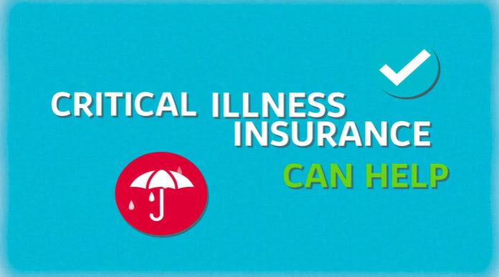

Critical Illness Insurance Can Help

Slide 8



Critical Illness Insurance
  Complements health insurance protection
  Quickly pays lump sum cash benefit upon the diagnosis of a critical illness regardless of any other insurance you may have
  Essential support when you need it most, to help:
  offset the cost of care and medical bills
  pay for additional treatment options, living expenses, help around the house or anything else you may need

Slide 9

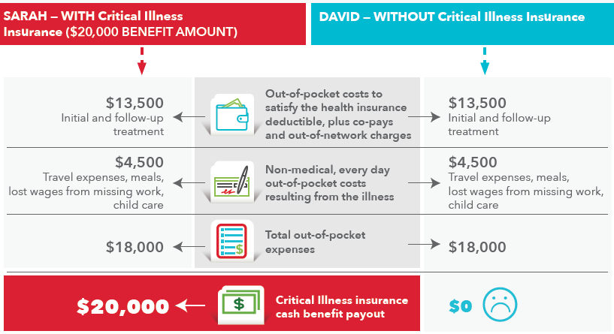

Slide 10
LifeSecure’s Critical Illness Covered Conditions
Specified Disease ** | % of Benefit Amount payable upon first diagnosis
Heart Attack | 100%
Stroke (CVA) ¹ | 100%
Coronary Artery Disease | 25%
Invasive Cancer | 100%
Carcinoma In Situ | 25%
Prostate Cancer ² | 25%
Skin Cancer ³ | 5%
End Stage Renal Failure | 100%
Major Organ Failure | 100%
¹ In NH: This disease is called Severe Stroke
² In CA: This disease is called Cancer Confined in its Site of Origin
³ In CA: This disease is called Excluded Skin Cancer
** In PA: Specified Disease is called Critical Illness.

Slide 11
Unlimited Lifetime Benefit Maximum
Re-Occurrence of Same Disease:
50% of the Benefit Amount that was payable for the initial diagnosis of a Specified Disease is payable for a re-occurrence of that disease, as long as the two diagnoses are at least 12 months apart, or 12 months treatment-free for Invasive Cancer (In AR & GA: 6 months for both).
  The Re-Occurrence Benefit is not available for Skin Cancer.
Subsequent Diagnosis of a Different Disease:
The full Benefit Amount (as shown on the previous slide for each disease) is payable for a subsequent diagnosis of a different disease, as long as each diagnosis is separated by at least 6 months (In NH: 0 months).
Unlimited Lifetime Maximum

Slide 12
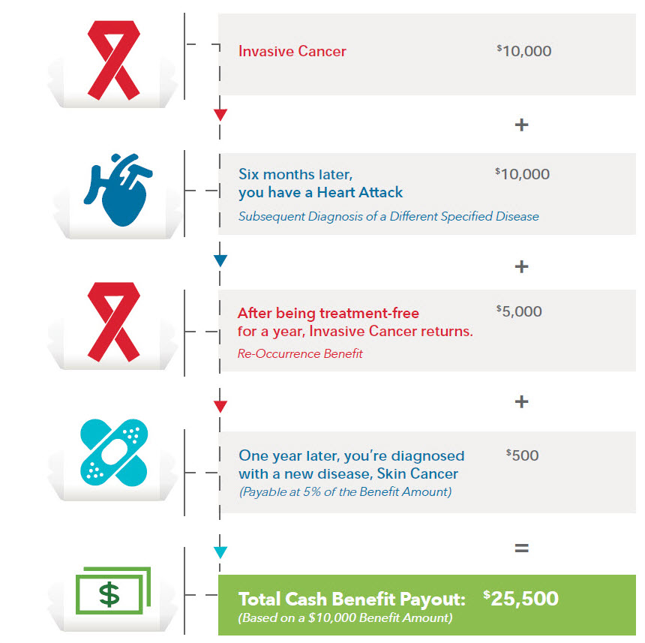
Benefit Payout Example

Slide 13
Why LifeSecure Critical Illness Insurance?
Provides lump sum cash benefit upon the diagnosis of a critical illness, regardless of any other insurance you may have
Eligible issue ages: 18 through 70 (In CA: 18 through 64)
Guaranteed renewable to age 75
Coverage for the Whole Family
  Dependent children are automatically covered with a $2,500 Benefit Amount at no additional cost (In NH: $2,000 Benefit Amount)
  If including spouse/partner, their Benefit Amount will be 50% of your amount (In GA: no coverage for partners)

Slide 14

How Might You Use Critical Illness Benefits?
You decide! For example, benefits can be used to help pay for:
  Medical deductibles, co-pays or co-insurance
  Other medical costs including prescriptions, second opinions, experimental treatments and out-of-network expenses
  Rehabilitative services
  Transportation to/from appointments or travel expenses to seek medical treatment outside of your community
  Mortgage/rent, auto loan payments, or other daily bills
  Help with lost wages while away from work
  Childcare and housekeeping help
  Anything else you want or need

Slide 15
How does Critical Illness Insurance Work?
Choose your Benefit Amount
  $10,000 (no medical questions or build chart)
  Or choose $15,000 or $20,000, with simplified underwriting
Health Screening Benefit (In MI & MN: Not available)
  Receive $50 for one of 30⁺ wellness procedures
  Once per calendar year/per covered person

Slide 16
Why You Should Consider Critical Illness Coverage
Which serious diseases or illnesses have impacted your circle of family and friends?
Did it create an unexpected emotional or financial strain on the household?
How would you cover out-of-pocket medical expenses and other costs of $5,000 or more?
Have a plan for the unexpected
Protect your hard-earned income and peace of mind during stressful times
Receive cash benefits to help you pay for care and recover with less worry
Notes:
Call back to the 3 questions at the beginning of the presentation

Slide 17

Contact Information
[Agent Name]
[Agency/Company Name]
[Phone]
[Website]
Questions?

