Slide 1

Accident Insurance with Accidental Death Benefit
Not available in: FL, NM and NY
Presented by:
[Agent Name]
[Agency/Company Name and or Logo]

Slide 2
How many times have your family and friends experienced an accidental injury?

Slide 3

Accidents Happen…
1 out of 7 Americans each year seeks medical care due to injuries
More than 90% of accidents are non-traffic related
Falls are the leading cause of accidental injuries among Americans in almost every age group
More than 2.6 million children under the age of 19 are treated in emergency departments each year for sports and recreation-related injuries
Sources: National Safety Council, Injury Facts, 2019 Edition.; Centers for Disease Control and Prevention, Feb. 2019

Slide 4
Did the accidental injury create an unexpected emotional or financial strain on the household?

Slide 5
Did you know?
Families are more worried about being able to afford an unexpected medical bill than any other household expense
About one-third of Americans struggle to pay their medical bills, including those with health insurance
Families are facing unprecedented levels of financial stress at home and in the workplace
Just one accidental injury could result in reaching your health insurance deductible or out-of-pocket maximum
Pairing Personal Accident Insurance with your medical plan can extend your protection to help with those unexpected costs – and help you focus on healing
Sources: Kaiser Family Foundation, Kaiser Health Tracking Poll, Sept. 2018; PwC Employee Financial Wellness Survey, 2019; Kaiser Family Foundation, Americans’ Challenges with Health Care Costs, March 2017.

Slide 6
How would you cover
out-of-pocket medical expenses and other costs of $5,000 or more?

Slide 7

Personal Accident Insurance Can Help
Notes:
Click the image to launch a YouTube video

Slide 8



Personal Accident Insurance
  Complements health insurance protection
  Quickly pays cash benefits following an accidental injury regardless of any other insurance you
  may have
  Assists in the recovery phase with financial support to offset unexpected costs

Slide 9
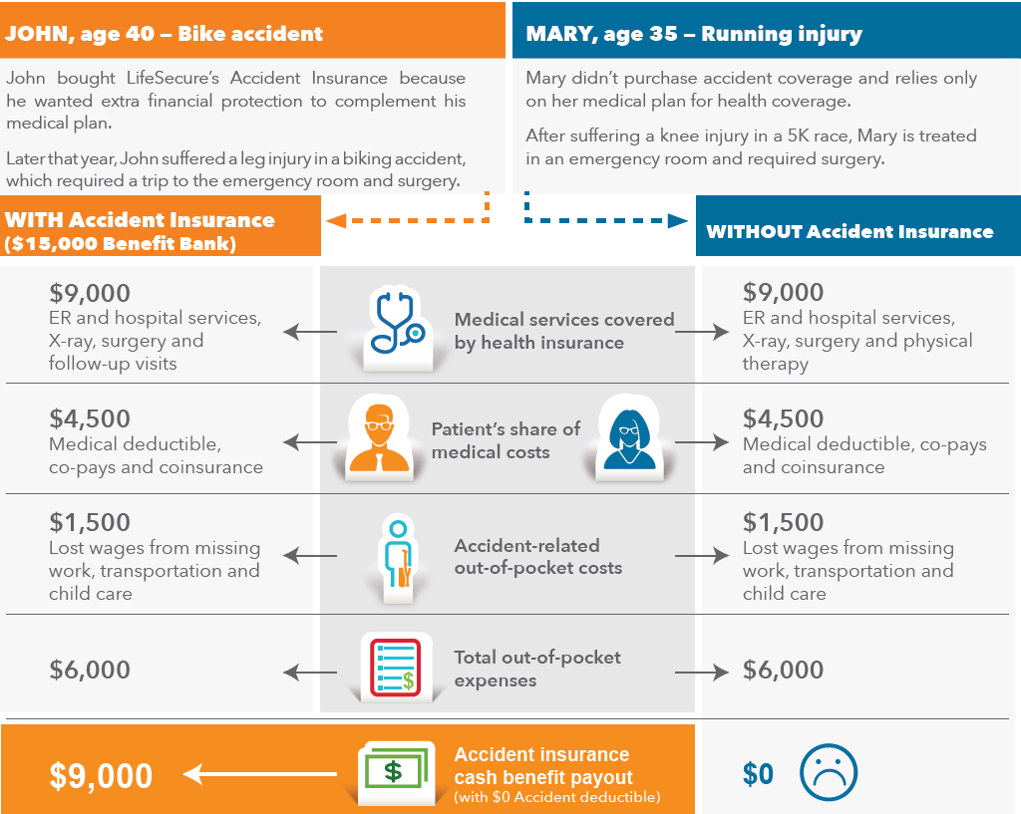
Notes:
Image links to flyer

Slide 10
Why LifeSecure Accident Insurance?
Eligible issue ages: 18 through 74 (in most states)
Guaranteed issue (no medical questions or build chart)
Guaranteed renewable to age 75 or 85, depending on state
Coverage for spouse/partner and children through age 25

Slide 11





How Might You Use Accident Insurance Benefits?
You decide! For example, benefits can be used to help pay for:
Uncovered medical deductibles, co-pays & co-insurance
Medications
Home care
Rehabilitative services
Housekeeping help
Child care
Lost wages while away from work
Mortgage payment/daily bills
Transportation to/from appointments
Stress reduction
Comfort during treatment
Anything else

Slide 12
Why LifeSecure Personal Accident Insurance?
Helps pay for unexpected expenses that result from an accidental injury, such as slip and fall, sports injuries, car accidents and more.
Initial care must be received within one week of accident (timeframe varies in certain states)
Benefit payouts are based on actual medical care and/or recovery costs, regardless of any other insurance you have. Reimbursement for services related to covered accidents, including:
  Follow-up visits
  Ambulance service
  Diagnostic exams (CT, MRI, EEG), tests and X-rays
  Surgery
  Rehabilitative services, including chiropractic care
Accidental Death Benefit (in most states)
24/7 Coverage – on the job & off the job

Slide 13


Why LifeSecure Personal Accident Insurance?
No confusing options – just one straightforward plan
Choose Your Annual Benefit Bank
Any amount within range, in $100 increments
  Minimum: $2,500
  Maximum:
      $15,000 for individuals (In MI: $25,000)
      $25,000 for couples/families (In MI: $50,000)
  Benefit can be used by one or all family members
Choose Your Annual Deductible
  $0 or $500 (individual)
  $0 or $1,000 (family)
In VA: $100 (individual) / $200 (family) deductibles

Slide 14
Why You Should Consider Accident Coverage
How many times have your family and friends experienced an accidental injury?
Did it create an unexpected emotional or financial strain on the household?
How would you cover out-of-pocket medical expenses and other costs of $5,000 or more?
Have a plan for the unexpected
Protect your hard-earned income and peace of mind during stressful times
Receive cash benefits to help you pay for care and recover with less worry
Notes:
Call back to the 3 questions at the beginning of the presentation

Slide 15

Contact Information
[Agent Name]
[Agency/Company Name]
[Phone]
[Website]
Questions?

